Slide 1
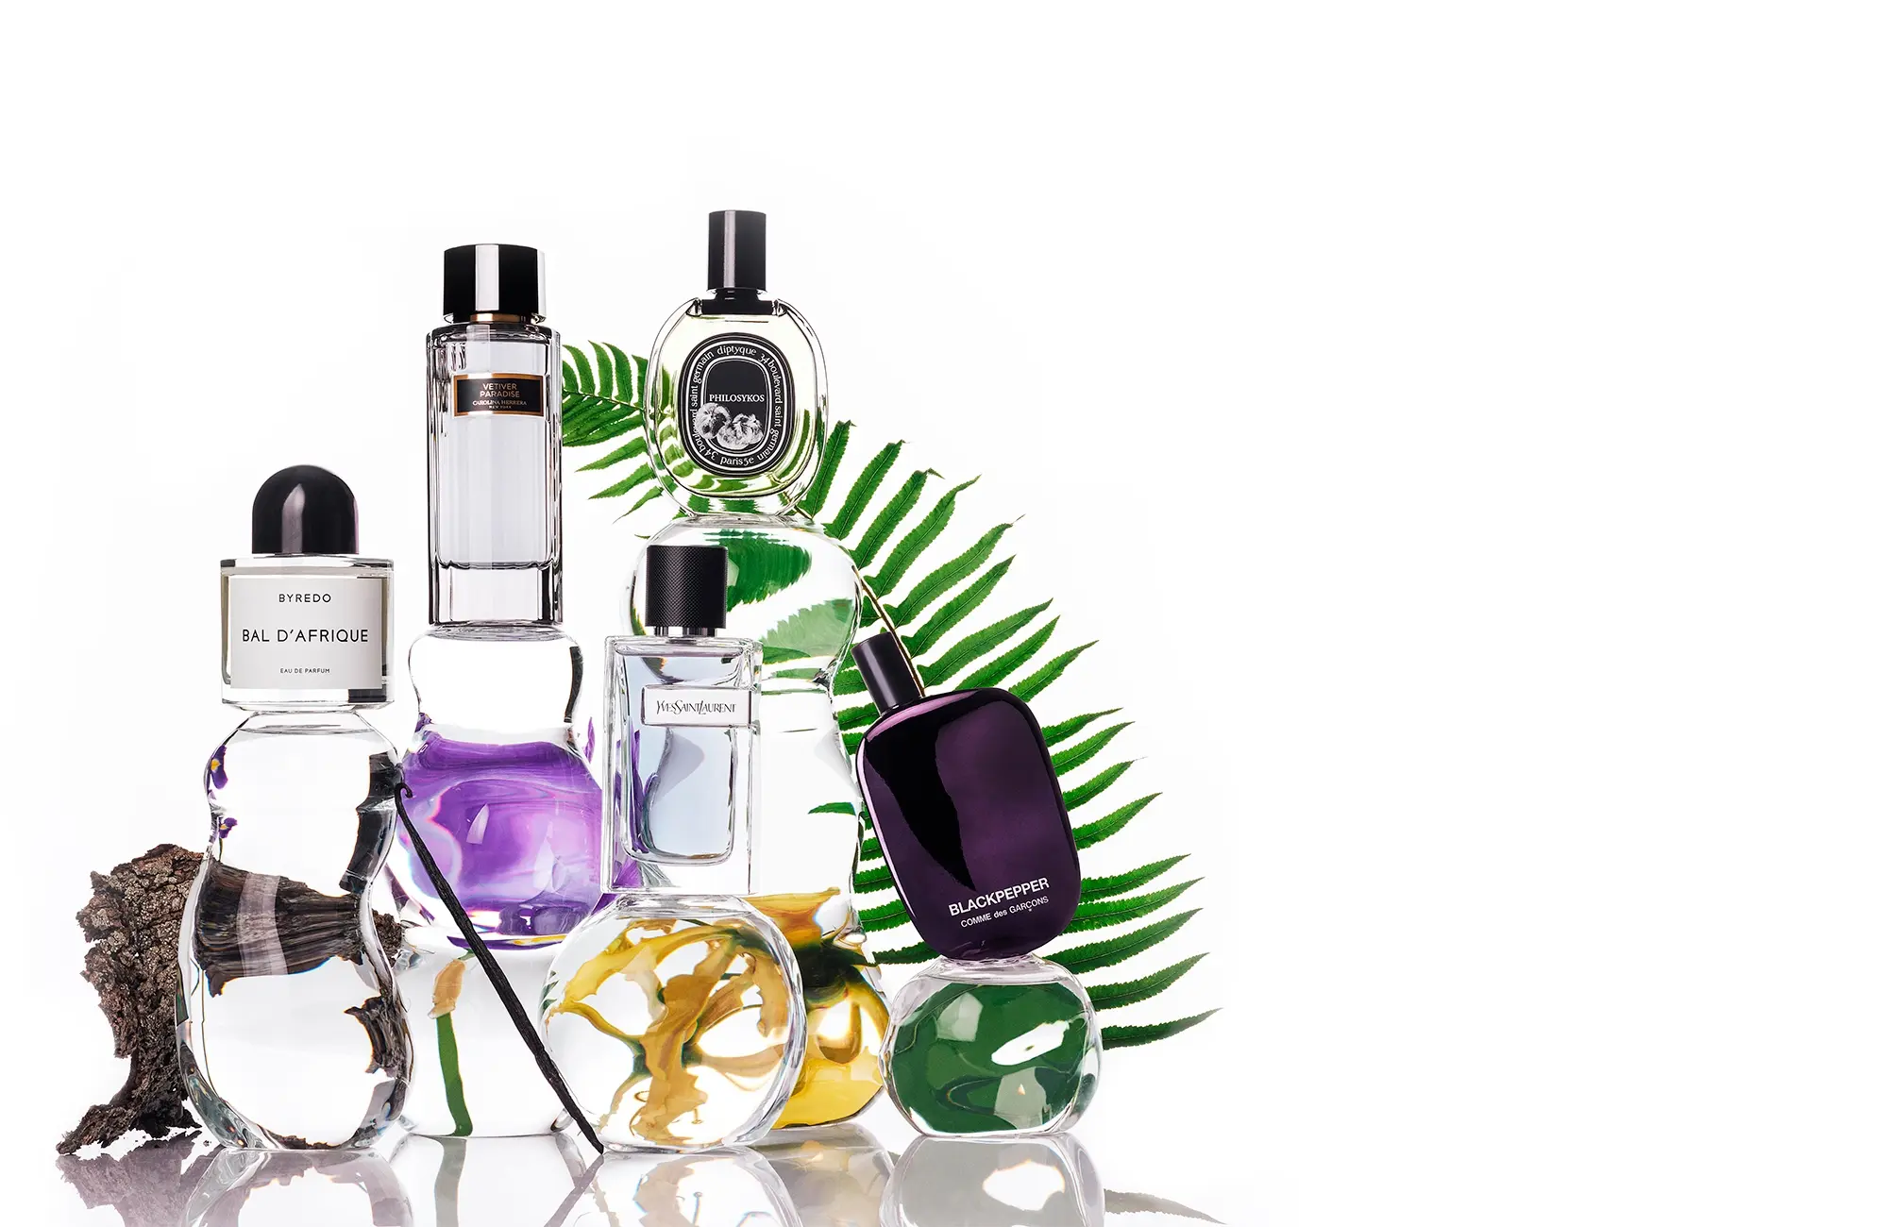
PERFUMEDIA The App for perfume lovers
Ying Wang
July 29, 2023
Final Project - Ironhack
Notes:
Line spacing + Page numbers

Slide 2

Agenda
01 Introduction
02 Design Flow
03 Streamlit Demo
04 Conclusion

Slide 3
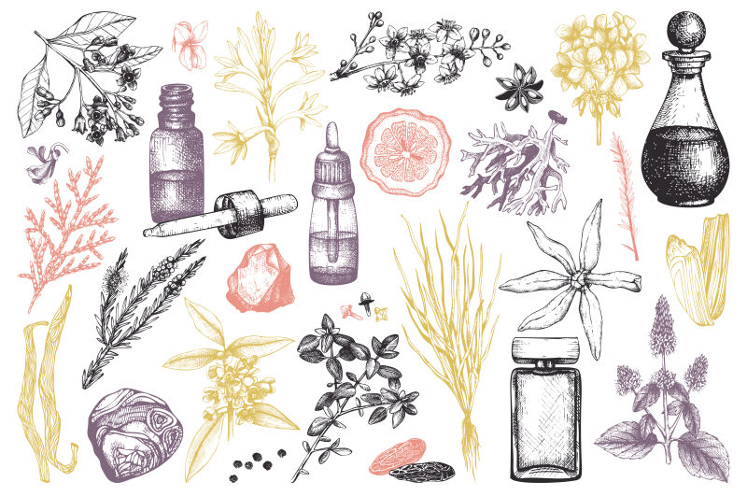


Introduction
01
Perfumedia - an immersive journey into the enchanting world of perfumes, designed to unlock the perfect scent that resonates with your soul.
We embark on an olfactory adventure that blends the richness of history, the art of data science, and the allure of cutting-edge technology.

Slide 4
Design Flow
02
Web Scraping
Data Preprocessing
EDA / Data Visualization
Data Processing / Modeling
Streamlit App
https://en.parfumdreams.de
Brand
Name
Category
Gender
Price
Notes
Fragrance
Customer ratings
Review counts
Image

Slide 5

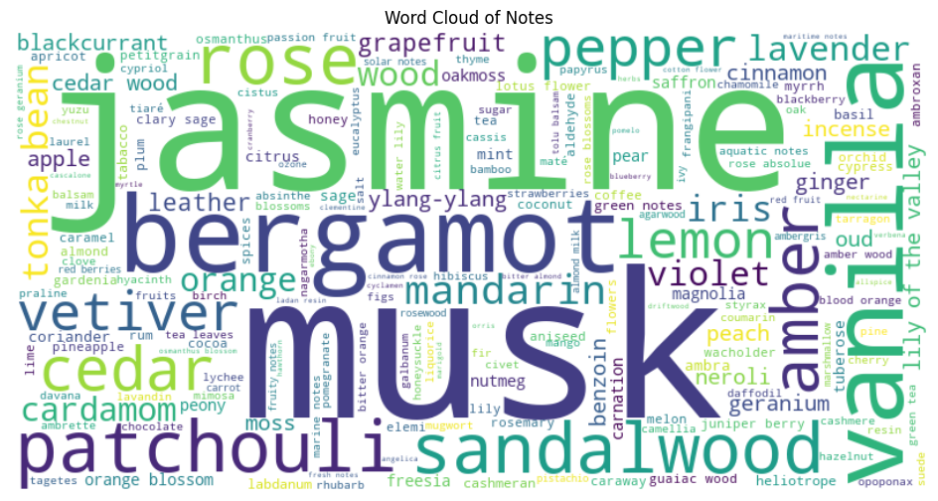





Data
2115 Perfumes
236 Brands
355 Notes
16 Fragrance
5 Categories
(EDP, EDT, Parfum, etc.)
Price range
8 ~ 1600 €/100ml

Slide 6
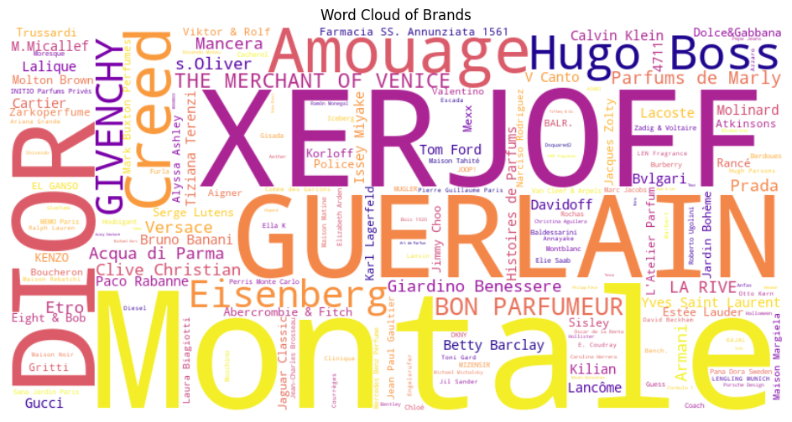
Data
2115 Perfumes
236 Brands
355 Notes
16 Fragrance
5 Categories
(EDP, EDT, Parfum, etc.)
Price range
7,95 – 1600 €/100ml

Slide 7
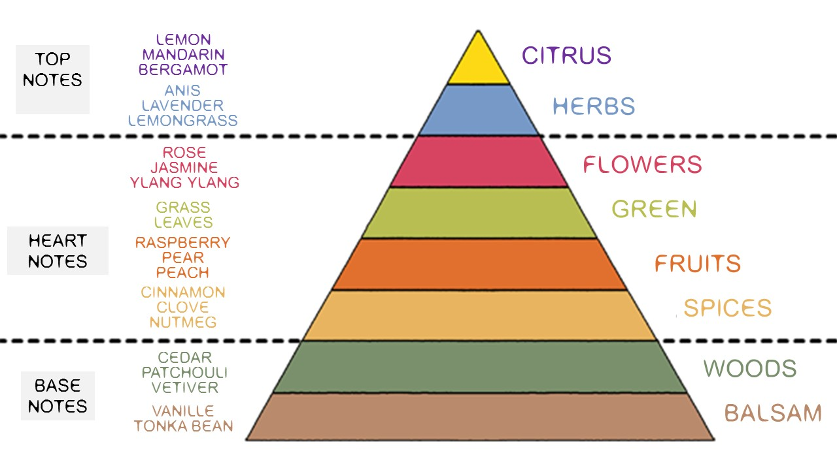
Data
2115 Perfumes
236 Brands
355 Notes
16 Fragrance
5 Categories
(EDP, EDT, Parfum, etc.)
Price range
7,95 – 1600 €/100ml
Notes
Fragrance

Slide 8
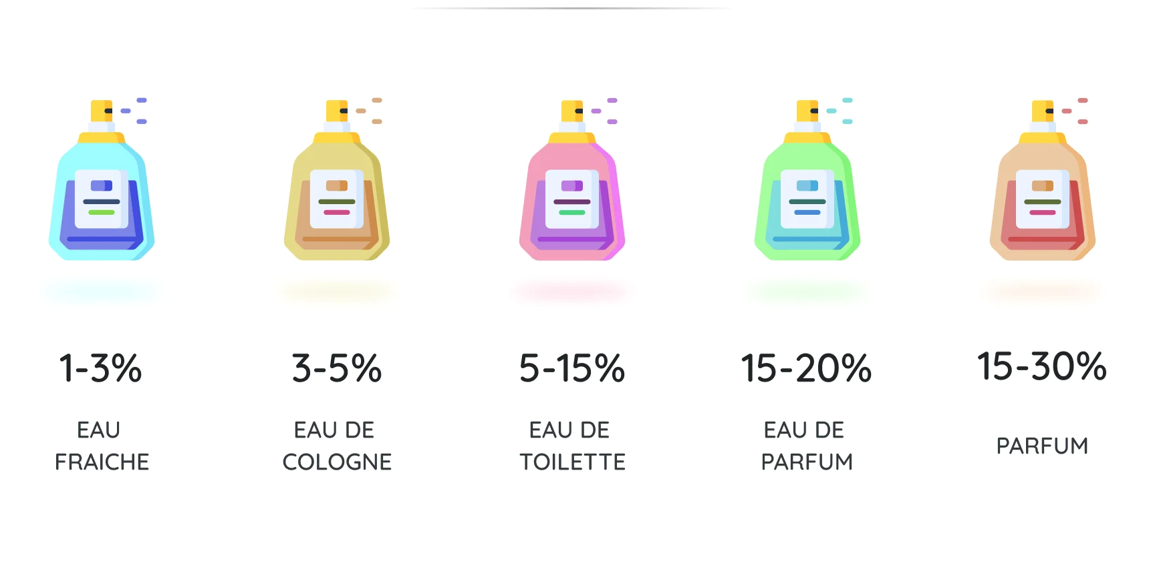
Data
2115 Perfumes
236 Brands
355 Notes
16 Fragrance
5 Categories
(EDP, EDT, Parfum, etc.)
Price range
7,95 – 1600 €/100ml
Categories

Slide 9
Design Flow
02
Web Scraping
Data Preprocessing
EDA / Data Visualization
Data Processing / Modeling
Streamlit App
https://en.parfumdreams.de
Brand
Name
Category
Gender
Price
Notes
Fragrance
Customer ratings
Review counts
Image
Models:
KNN
Random Forest
XGBoost
Cosine Similarities

Slide 10
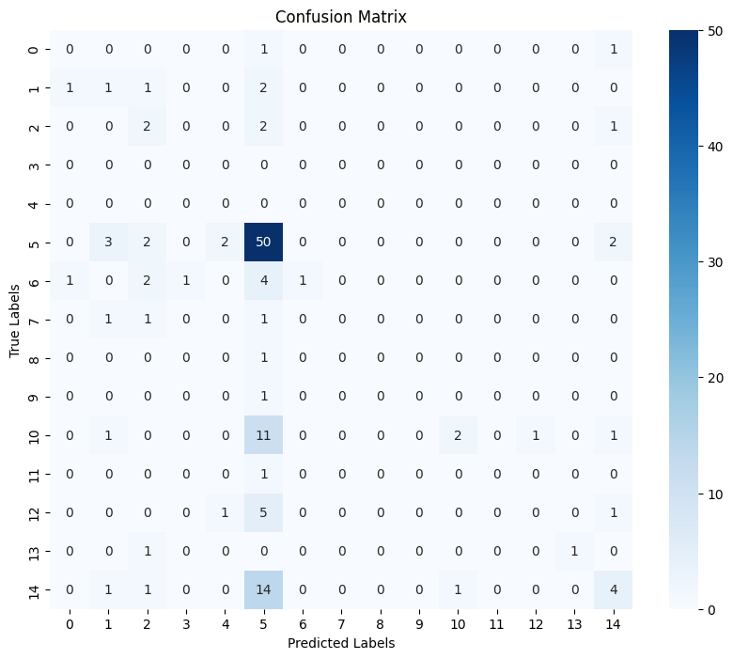
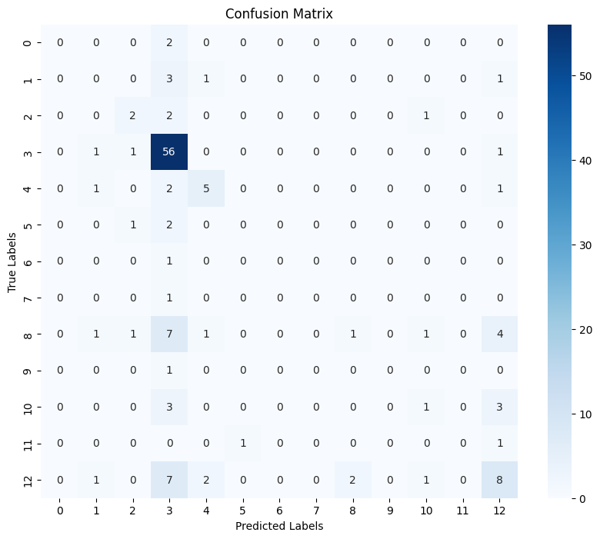
Models
KNN
Accuracy: 0.4621
Precision: 0.4811
Recall: 0.4621
F1-Score: 0.4008
Random Forest
Accuracy: 0.5530
Precision: 0.4614
Recall: 0.5530
F1-Score: 0.4819
XGBoost
Accuracy: 0.5303
Precision: 0.5028
Recall: 0.5303
F1-Score: 0.5103

Slide 11
Design Flow
02
Web Scraping
Data Preprocessing
EDA / Data Visualization
Data Processing / Modeling
Streamlit App
https://en.parfumdreams.de
Brand
Name
Category
Gender
Price
Notes
Fragrance
Customer ratings
Review counts
Image
Models:
KNN
Random Forest
XGBoost
Cosine Similarities
Perfume finder by brand and/ or name
Perfume finder of similar perfumes
Perfume recommender

Slide 12

Streamlit Demo

Slide 13
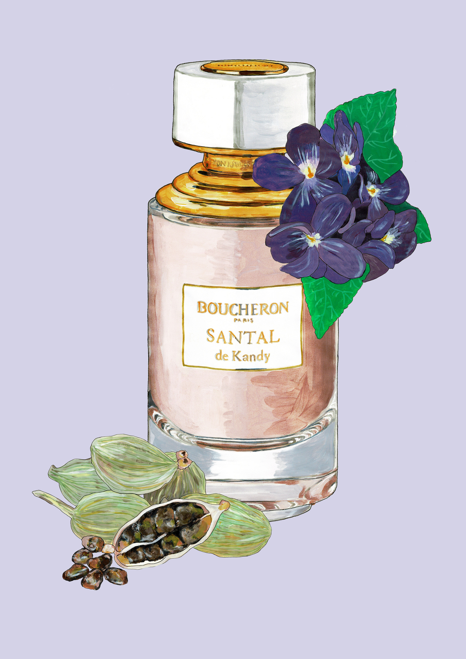
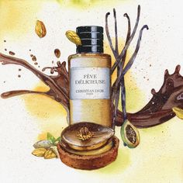
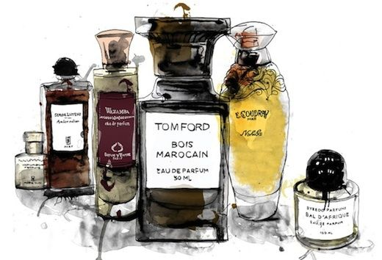
Conclusion
04
Welcome to Perfumedia
- where the power of scent meets the magic of data science, and the beauty of perfumery becomes an unforgettable experience.

